Slide 1
SNAKE GAME PROJECT At IU, June 08th 2020, Semester 2 (2019 – 2020)
02/2020
Author: Group 01

Slide 2


About Us
Leader: PHAM HOANG MINH
ID: ITITIU19031 (30%)

Slide 3

About Us
Member: HA MINH KHOA
ID: ITITIU19020 (70% / 3)

Slide 4
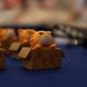
About Us
Member: TRUONG NHAT MINH QUANG
ID: ITITIU19194 (70% / 3)

Slide 5
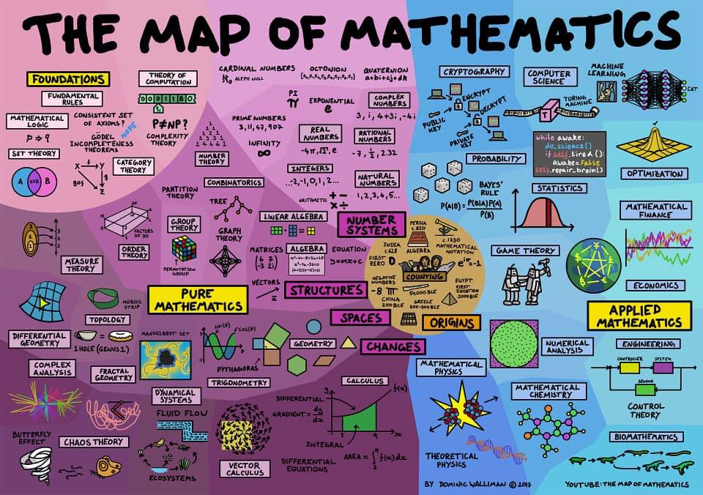
About Us
Member: TRAN MINH QUANG
ID: ITITIU19192 (70% / 3)

Slide 6
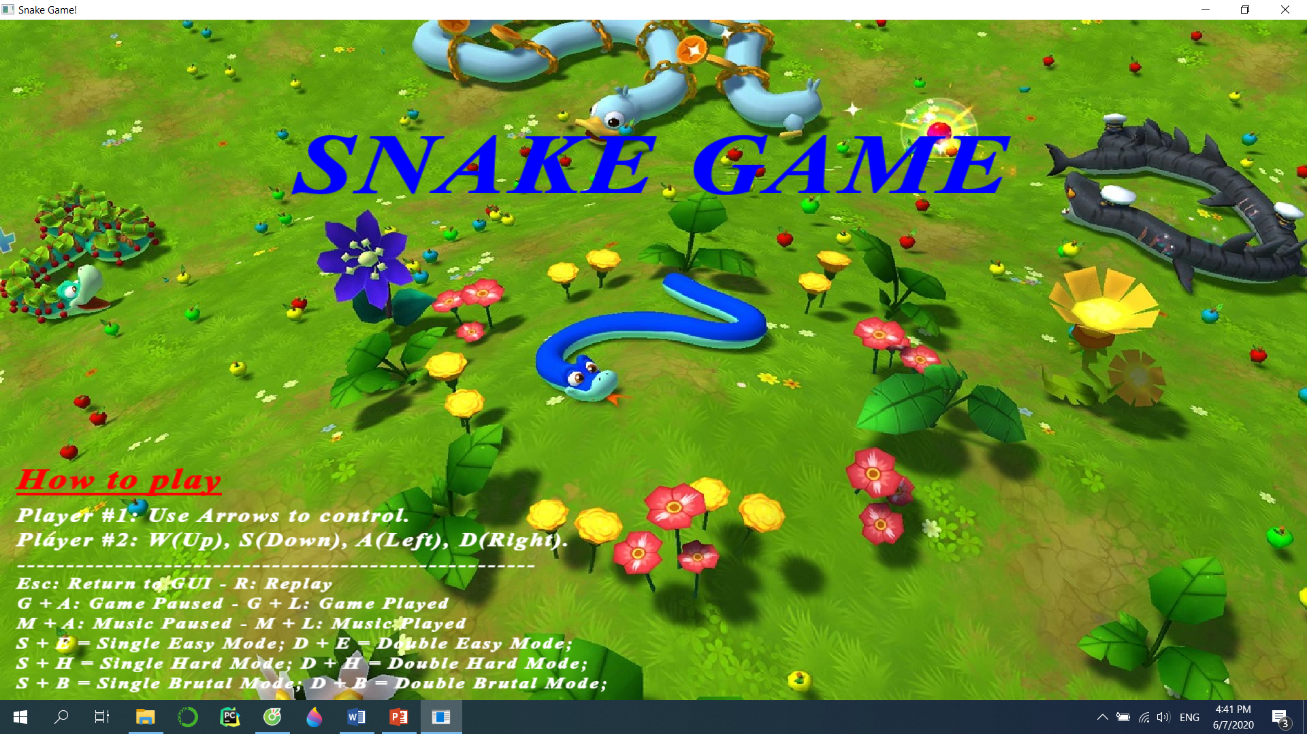

Slide 7


Slide 8
ATTENTION
This is not
Normal SNAKE GAME

Slide 9
ATTENTION
This is not
Normal SNAKE GAME

Slide 10
ATTENTION
This is called
“NHÂN PHẨM” GAME

Slide 11
ATTENTION
This is called
“NHÂN PHẨM” GAME

Slide 12
WHERE YOU NEED
Higher level of “nhân phẩm” than League of Legends – Teamfight Tactics
Powerful – jet engine eye vision to see hidden obstacles
Prediction skills with high IQ level to predict whether obstacles snaps into your stupid face.
Ultra reflection speed to dodge every obstacles, especially in “Deadly” Bonus Time

Slide 13
16 x 16
16 x 16
16 x 16

Slide 14
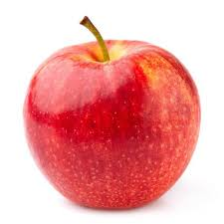
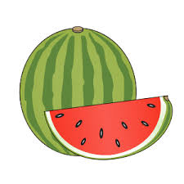
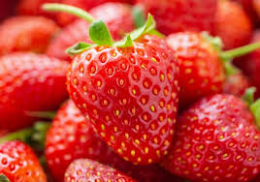
SFML Library
Food
https://www.sfml-dev.org/index.php
Multi-media, multi-platform, and multi-language.
Tutorial: included in GitHub with the name: Snake-Game-at-IU (public) – Full instruction to install the game
Three types of Fruit with random generator:
Apple: 2 points
Melon: 5 points
Strawberry: 10 points

Slide 15


Large image
ADDITIONAL FEATURES

Slide 16

Music
Game Status
Six (06) suitable music included
Can choose to pause or replay that music again without causing troubles
Restart function: Reset the game and randomize music
Immediate troubles from players. How to solve?
Pause, Replay, Restart, Mode Changing, and Exit button

Slide 17

Score Database
Programmers wants players to achieve some extent of satisfaction through score comparison.
No score is stored because player will continue playing over and over which decrease the working efficiency and attention, causing insomnia and headache if scores are stored

Slide 18

Game Mode (Part 01)
Six (06) different Game Mode: Single Easy, Single Hard, Single Brutal, Double Easy, Double Hard, Double Brutal (changeable).
Differentiating by “Delay” variable, Game Rules, and Obstacles

Slide 19
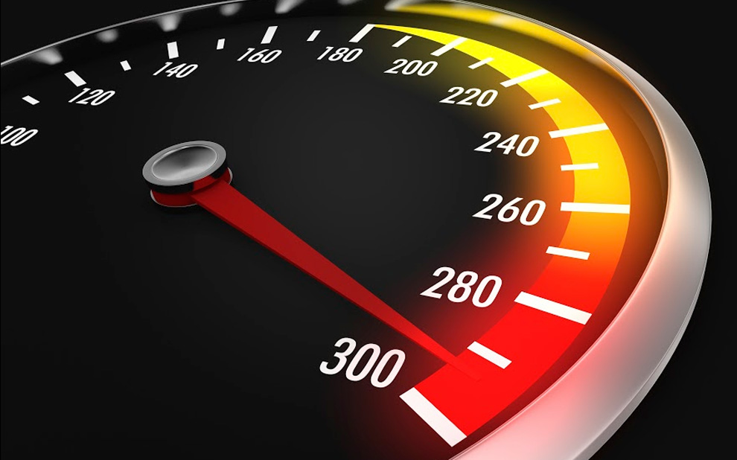
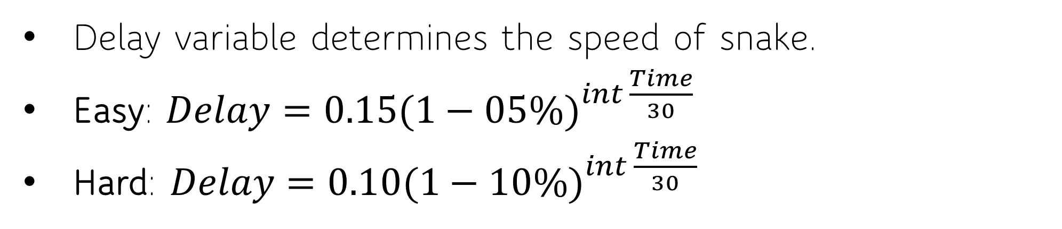
Game Mode (Part 02) – Delay variable
Delay variable determines the speed of snake.
Easy: $Delay={0.15(1−05\%)}^{int \frac{Time}{30}}$
Hard: $Delay={0.10(1−10\%)}^{int \frac{Time}{30}}$

Slide 20
Game Mode (Part 02) – Delay variable
Most will fail after 15 minutes in Easy Mode and 7.5 - 10 minutes in Hard Mode and 5 minutes after 5 minutes in Brutal.
(Human Reaction ranging from 0.1 s <-> 0.3 s)

Slide 21
Time Passed (s) | Delay (s) in Easy Mode | Delay (s) in Hard Mode
0 | 0.15 | 0.1
60 | 0.1353 | 0.081
240 | 0.0995 | 0.0478
300 | 0.0898 | 0.0348
450 | 0.0694 | 0.0205
600 | 0.0537 | 0.0121
900 | 0.0323 | 4.239 x 10⁻³
1200 | 0.0193 | 1.478 x 10⁻³
1800 | 6.91 x 10⁻³ | 1.797 x 10⁻⁴
2400 | 2.477 x 10⁻³ | 2.185 x 10⁻⁵
3600 | 3.184 x 10⁻⁴ | 3.229 x 10⁻⁷

Slide 22

Game Mode (Part 03) – Game Rules
EASY MODE
Snake can pass wall, bite himself or other Snake
Low Speed Initial, less Obstacles (still random)
HARD MODE
Snake cannot pass wall, or bite other Snake
High Speed Initial, more Obstacles (still random)

Slide 23

Game Mode (Part 04) – Obstacles
EASY MODE
Durations: 20 seconds
After 35 seconds passed:
ObstacleNumber += 10;
HARD MODE
Durations: 30 seconds
After 45 seconds passed:
ObstacleNumber += 30;

Slide 24
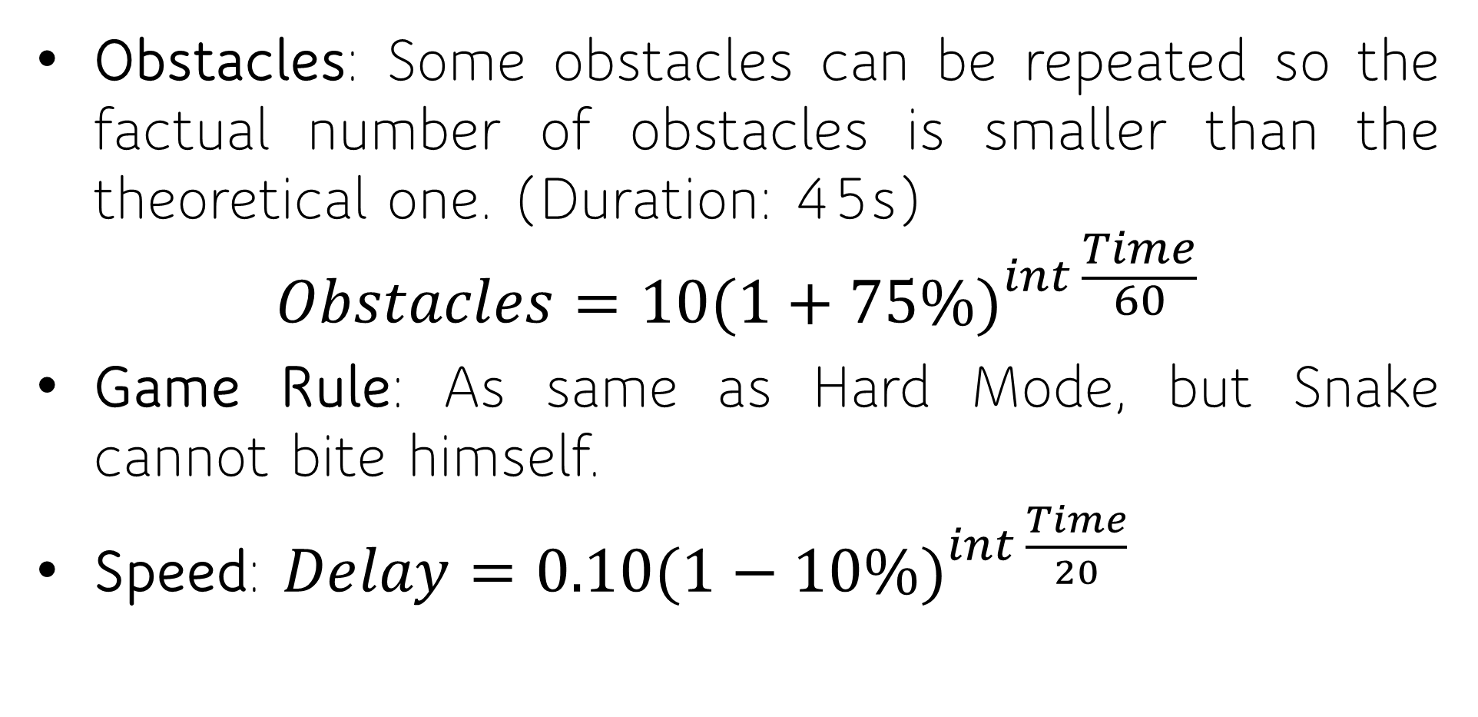
Game Mode (Part 05) – Brutal Mode
Obstacles: Some obstacles can be repeated so the factual number of obstacles is smaller than the theoretical one. (Duration: 45s)
$$Obstacles={10(1+75\%)}^{int \frac{Time}{60}}$$
Game Rule: As same as Hard Mode, but Snake cannot bite himself.
Speed: $Delay={0.10(1−10\%)}^{int \frac{Time}{20}}$

Slide 25
Time Passed (s) | Delay (s) in Brutal Mode | Number of Obstacles (Theoretical)
0 | 0.1 | 10
60 | 0.0729 | 17
120 | 0.0531 | 30
180 | 0.0387 | 53
240 | 0.0282 | 93
300 | 0.0205 | 164
360 | 0.015 | 287
420 | 0.0109 | 502
480 | 7.977 x 10⁻³ | 879
540 | 5.815 x 10⁻³ | 1539
600 | 4.239 x 10⁻³ | 2639

Slide 26
Game Mode (Part 06) – Bonus Time
After 75 seconds in silence, there are 150 fruits available on the screen (theoretical) on the screen for 15 seconds before disappearing. However, this bonus time can cause death if players does not pay attention.
Score = Score - 50
Length = Length - 25
Score = Score + 10
Length = Length + 5
Score = Score + 20
Length = Length + 10

Slide 27
Note
Obstacles can appear randomly without warning to increase the Game Difficulty. But you will only die if you hit the Snake’s Head into it. Obstacles will appear again after 15 seconds of disappearing.
If you are unlucky, “nhân phẩm kém, thích cà khịa”, the Obstacle will appear right on the Food’s place, so you will have to wait.
There is one cheat code to pass two annoying situations if you are the one with “nhân phẩm kém, thích cà khịa”

Slide 28
Recommendations
In order to achieve highest level of satisfaction:
A personal computer (PC) or laptop is a must.
You must have the ability of counting time, guessing Obstacles, and tricking partners (you have to be smart if you played in Double Mode)
You have to be patient at all time.
You must have high luck. Do not overuse your lucky point overwhelmed.
You have already known the rules thoughtfully.
Note: You have to experience Easy Mode at the first trial (Three to five times for sure) before trying at Hard Mode or Brutal Mode. You have to pass at least three to five times with at least five (05) minutes each at Easy Mode before reaching to Hard Mode, and at least three to five times with at least three (03) minutes each at Hard Mode.

Slide 29

Large image
CONCLUSION
WORTH-PLAYING GAMES

Slide 30
CITATIONS
SFML Library: https://www.sfml-dev.org/index.php
Git-Hub Repository: https://github.com/IchiruTake/Snake-Game-at-IU

Slide 31





THANK YOU
Pham Hoang Minh
ITITIU19031
ITITIU19031@student.hcmiu.edu.vn
Group 01

